Slide 1

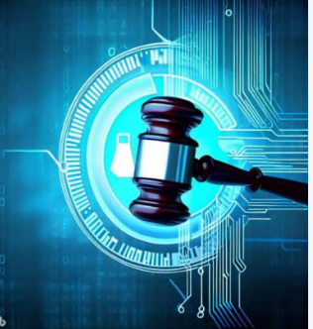
Impact of Artificial Intelligence on the Legal System

Slide 2
Agenda
Introduction
How AI Can Bring Reforms to the Legal System
AI: The Future Assistance for Lawyers
How AI Will Reshape the Judicial System Globally
Current AI Systems in the Legal Field
AI: Boon or Bane to the Legal Sector?
Conclusion

Slide 3
Introduction
Overview
Artificial Intelligence (AI) has rapidly transformed numerous sectors by enhancing efficiency, accuracy, and decision-making capabilities. In the legal field, AI applications are beginning to reshape traditional practices, offering tools for legal research, case prediction, and document analysis. While AI holds the promise of streamlining operations and reducing the backlog of cases, it also presents challenges, such as concerns over data security, potential job displacement, and the need for ethical considerations in its implementation. Understanding the current state of AI and its implications for the legal system is crucial as the legal community navigates this technological evolution.

Slide 4
Traditional Legal Research vs AI-Driven Legal Research
Comparison
Traditional Legal Research
Manual search in law libraries using print resources like case reporters and legal encyclopedias.
Time-consuming due to manual searching and cross-referencing.
Limited to the availability of physical resources and researcher’s ability.
Dependent on the researcher’s expertise, prone to human error.
Timeliness of printed resources may limit usefulness.
AI-Driven Legal Research
Automated search using AI algorithms accessing digital databases and online resources.
Significantly faster as AI processes vast amounts of data quickly.
Widely accessible from any location with internet connectivity.
High accuracy in finding relevant cases, reducing human error risk.
Continuously updated with the latest cases and legal information.

Slide 5
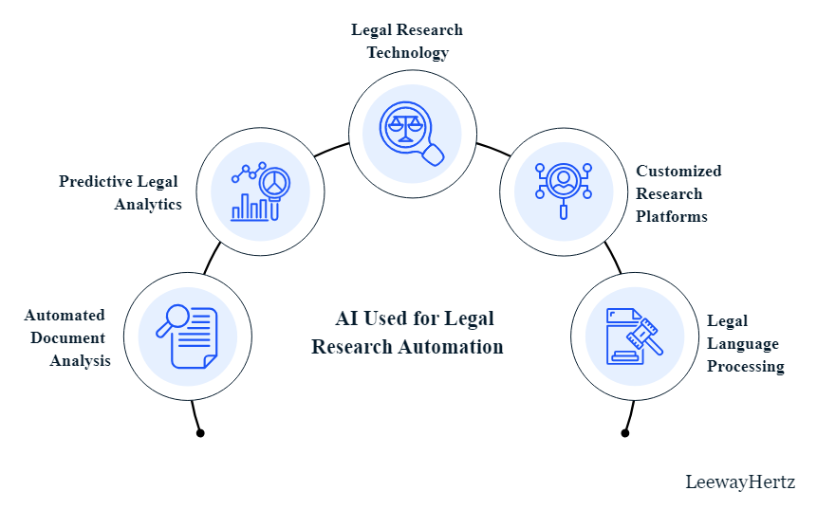

Slide 6
How AI Works for Legal Research
Process
Data Sources
Data Pipelines
Embedding Models
Query Execution
The process begins with collecting data from essential sources for legal research, including case law, statutes, court filings, and legal databases.
Data is directed through pipelines that manage ingestion, cleansing, and processing, preparing it for analysis and querying.
Processed data is segmented and transformed into numerical representations (vectors) using embedding models for accurate interpretation.
When a user submits a query, the system retrieves relevant data from the vector database and sends it to a selected LLM for processing.
Comprehensive data set
Diverse legal sources
Cleaned and processed data
Organized datasets
Numerical representations
Ready-to-query vectors
Contextual output from LLM
Detailed responses to queries

Slide 7
Legal research
Analyze extensive legal databases to extract relevant case laws, statutes, and precedents.
Provide real-time, contextual insights into legal queries, simplifying the research process.
Automate updating legal databases to ensure access to the most current information.
Implement advanced search filters that help narrow search results to the most relevant documents.
Automatically link relevant cases and statutes based on the context of the research query.
Summarize long legal documents into concise, digestible formats for quick review.
AI tools such as research databases, chatbots, and document review software can very well resolve our queries.

Slide 8
Generate automatic pleadings
AI can also help lawyers in creating automatic pleadings.
It can be used in producing discovery responses, responsive pleadings, and other documents.
The only thing the lawyers have to do is to upload the complaint or the discovery request along with the jurisdictional requirements.
Legal Mation is one such company that has already made such a system. It uses different AI technologies to produce several types of automated legal documents using the lawyer’s own style of formatting and response strategy.

Slide 9
Document drafting and review:
Automate drafting of legal documents such as briefs, contracts, and pleadings with AI-assisted templates.
Conduct thorough reviews of legal documents to identify inconsistencies or potential legal issues.
Enhance document accuracy and compliance with current laws and regulations.

Slide 10
Settlement of cases based on predictive analysis
One of the biggest problems faced by the judiciary is a large number of pending cases and the shortage of judges to make decisions on those motions.
To solve such problems, courts can apply predictive analysis and visualization to show the probable outcomes of a lawsuit to the litigating parties so that the parties opt for an out of court settlement among themselves.
This will help the parties to avoid the long and complicated trial procedures and will also save the time of the court.

Slide 11
Client interaction and reporting:
Generate tailored legal reports automatically, providing clients with detailed and personalized insights.
Offer client support for basic legal queries and case updates, enhancing client service and satisfaction.
Facilitate apt communication to maintain regular updates and engagement with clients.

Slide 12
How AI Can Bring Reforms to the Legal System
Reforms
Reducing Time for Legal Procedures
Early Detection of Risks
Improving Client Relationships
AI can streamline various legal processes, significantly reducing the time required for tasks such as document review and legal research. Automation of routine tasks allows legal professionals to focus on more complex issues.
AI tools can analyze vast amounts of legal data to identify potential risks and challenges early in the legal process. This proactive approach enables lawyers to address issues before they escalate, improving outcomes.
By automating mundane tasks, lawyers can dedicate more time to client interaction, enhancing communication and service. AI can also provide clients with timely updates and insights, fostering trust and satisfaction.

Slide 13
How AI Will Reshape the Judicial System Globally
Document Review
Summarization
Administrative Tasks
Legal Research
AI tools can analyze legal documents quickly, highlighting key information and reducing the time judges spend on document examination.
AI can create concise summaries of lengthy legal documents, enabling judges to understand essential information rapidly and make timely decisions.
AI can handle administrative functions like scheduling and record-keeping, allowing judges to focus on legal matters rather than routine tasks.
AI enhances legal research by swiftly identifying relevant case law and precedents, providing judges with necessary information for fair verdicts.
Automated analysis reports
Key evidence highlights
Time-saving summaries
Case summaries
Quick reference guides
Interim order drafts
Automated scheduling alerts
Case management systems
Record-keeping efficiency reports
Relevant case law summaries
Precedent analysis
Legal insight reports

Slide 14


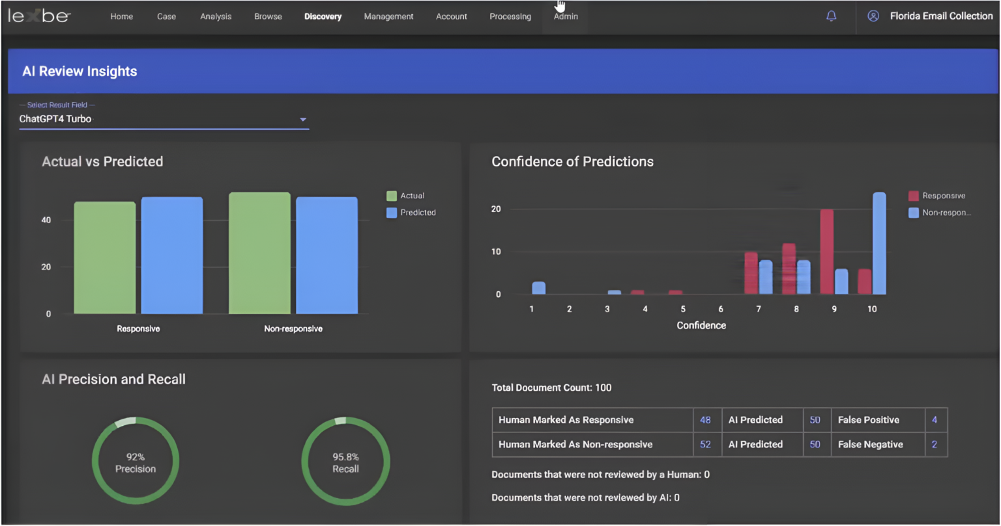
Current AI Systems in the Legal Field
ROSS Intelligence
KIRA Systems
eBrevia
An AI-powered legal research tool utilizing Natural Language Understanding to provide relevant legal cases in response to user queries.
A machine learning tool designed for contract review, capable of identifying and extracting clauses efficiently from legal documents.
An AI system that automates the extraction of relevant information from legal documents, significantly reducing time spent on document review.

Slide 15
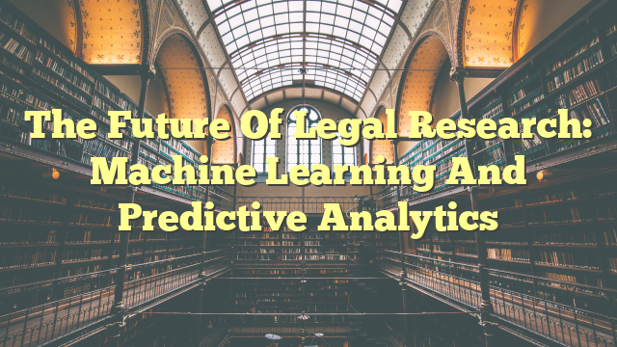
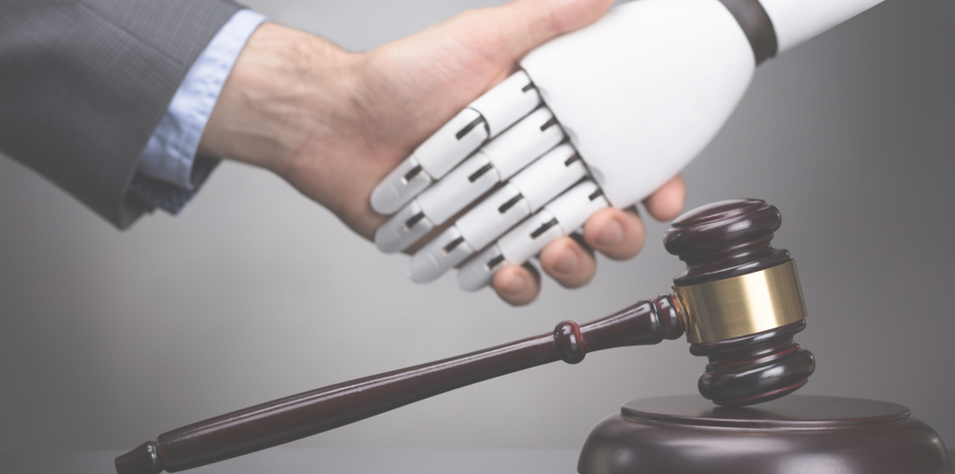
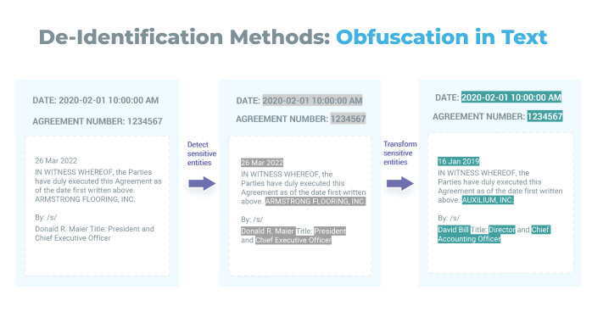
Applications of AI for Legal Research Automation
Applications
Predictive Legal Analytics
AI analyzes historical case data to predict outcomes based on past rulings, assisting in strategic decision-making.
Legal Research Technology
AI-powered tools automate citation checking and summarizing legal findings, enhancing research efficiency and accuracy.
Legal Language Processing
NLP tools simplify complex legal jargon, making legal documents more accessible and improving search accuracy.

Slide 16
Benefits of AI for Legal Research
Benefits
Efficiency
Accuracy
Cost-Effectiveness
Personalization
AI tools can process vast amounts of legal data rapidly, significantly reducing the time legal professionals spend on research tasks.
Advanced algorithms enhance the precision of legal research, minimizing human errors and ensuring reliable information retrieval.
By automating routine research tasks, AI reduces the need for extensive human resources, resulting in overall cost savings for law firms.
AI systems can customize search results based on user preferences and past queries, improving the relevance of retrieved legal information.

Slide 17
When to Perform AI-Powered Automated Legal Research
Applications
Handling Large Volumes of Data
Conducting Preliminary Research
Meeting Tight Deadlines
AI is ideal for processing vast amounts of legal documents and case law, enabling quick sifting through extensive datasets that would be impractical for manual review.
During the initial stages of legal inquiries, AI can swiftly summarize key cases and statutes, providing a foundational understanding before deeper manual research.
In urgent situations, such as litigation or contract negotiations, AI-powered tools can deliver research results much faster than traditional methods, ensuring timely decision-making.

Slide 18
AI Tools for Legal Research
Tools
Legal Text Analytics Tools
Q&A Tools
Automated Note-Up Tools
These tools employ algorithms to interpret legal texts, extracting meaningful data and insights from court decisions and laws, enhancing case preparation.
These tools search large text collections to answer legal questions, providing citations and suggested readings, helping legal professionals find information quickly.
These tools help lawyers determine the authority of legal decisions by exploring citation networks, streamlining the process of verifying case relevance.
Legal Prediction Tools
Contract Review Tools
E-Discovery Tools
These tools analyze past court decisions to predict outcomes of current cases, assisting lawyers in assessing risks and formulating strategies.
These tools review legal documents at the clause level, identifying potential risks and ensuring compliance, thus saving time in the review process.
These tools assist legal teams in managing document reviews during litigation, utilizing technology-assisted review to enhance accuracy and efficiency.

Slide 19
Legal and Ethical Considerations in Using AI for Legal Research
Ethics
Legal Considerations
Ethical Considerations
Compliance with data privacy laws like GDPR and CCPA is necessary.
AI tools must ensure client confidentiality and protect sensitive information.
Intellectual property rights issues arise regarding AI-generated content.
Adherence to software licensing agreements is essential.
Algorithmic bias can lead to unfair or skewed legal outcomes.
Transparency in AI decision-making processes is crucial to maintain trust.
Over-reliance on AI may undermine the development of critical legal skills.
Establishing accountability for AI errors in legal research is necessary.

Slide 20
Application of generative AI
Generative AI plays a significant role in legal research automation. It is used for generating and analyzing legal content, drafting documents, and suggesting legal arguments based on extensive legal databases.
Predictive modeling is another area where generative AI is making strides, enabling the creation of models based on past legal decisions and trends to predict future outcomes.
AI is significantly transforming the field of legal research by providing a range of tools and methods, from natural language processing and predictive legal analytics to customized research platforms and legal language processing

Slide 21
AI: Boon or Bane to the Legal Sector?
Analysis
Advantages of AI in the Legal Sector
Disadvantages of AI in the Legal Sector
Significantly reduces the time required for legal research and document analysis, allowing lawyers to focus on more complex legal issues.
Improves accuracy in predicting case outcomes by analyzing large datasets and past rulings, aiding lawyers in client advisement.
Enhances efficiency in handling repetitive tasks such as document review and contract analysis, leading to cost savings for law firms.
Facilitates better access to justice by making legal services more affordable and available to a broader audience.
Promotes consistency in judicial decisions by minimizing human biases during case evaluations.
Lacks the ability to replicate human creativity and intuition, which are often crucial in complex legal matters.
Risk of job displacement for legal professionals, particularly those in roles involving routine tasks, due to automation.
Dependence on technology can lead to issues if AI systems fail or produce incorrect results, potentially affecting case outcomes.
Concerns about data privacy and security, as sensitive client information may be vulnerable to breaches in AI systems.
Ethical dilemmas surrounding accountability for AI-generated decisions in the legal context, as existing legal frameworks may not adequately address these issues.

Slide 22
Implementation of AI by Judiciary
in various countries

Slide 23
SUPACE
INDIA
The Supreme court through to portal intends to use machine learning to deal with the amount of data received regarding the various cases.
Item es to hybrid system and to perfect combination of human intelligence and machine learning that works wonders in combination with human intelligence.
The AI- controlled tools designed to process only information and make Item
in the decision-
Judges dealing with criminal matters would use Item on an experimental
basis.

Slide 24
SUVAS
The 'Supreme court Vidhik Anuvaad Software' is a machine- assisted translation tools trained by Artificial Intelligence.
SUVAS you have the capacity and capability of translating English Judicial documents, orders, or Judgments into nine vernacular language scripts and vice versa.
Este es the first step towards the introduction of Artificial
Intelligence in the Judiciary Domain.”

Slide 25
The technologies developed by ManCorp Innovations lab (MCIL) could prove crucial for judges, especially at to time when there courts have gone on-line and the use of paper has largely reduced.
For Jharkhand High Court, the company had developed two pieces of technology
Optical Character Recognition (OCR) - which converts scanned documents into
computers readable text, corrects the orientation, etc
ChatBot - controlled by both voice commands and text.
In order to make operational, an exhaustive list of about 120-150 questions that would naturally crop up in to judge's mind when looking at criminal cases, especially cases of murder, were framed. Thereafter, to bunch of similar cases were labelled in the system, which made reading of files to smooth and quick endeavour.

Slide 26
USA
Supreme court of the United States (SCOTUS) with an accuracy of 70.2%, and the voting behavior of individual judges with 71.9% accuracy.
AI-powered tools such as COMPAS (Correctional Offender Management Profiling for Alternative Solutions) assist judges in risk assessment by analyzing factors such as criminal history, social and economic background and mental health to predict the likelihood of recidivism. The US Sentencing Commission also utilizes AI to create and enforce sentencing guidelines for fair and just punishment.
The US court system utilizes chatbots to offer answers to frequently asked questions about court procedures, schedules and other related subjects to the general public. This helps lessen the workload of court staff and enhances accessibility of information for everyone.

Slide 27
United Kingdom
Harm Assessment Risk Tool’ (or ‘HART’) uses algorithmic tools in a policing context that result in a ‘better’ outcome from the following perspectives: public safety, legal, and cost/resources. It does this by focusing upon an algorithmic risk-assessment tool the HART model uses behavioural predictors, in combination with age, gender, residential postcode etc which could ‘be viewed as indirectly related to measures of community deprivation.’
It makes predictions based on historical offender data, and so will be affected by past arrest history, force targeting decisions, social trends and prioritisation of certain offences (such as, recent child sexual abuse offences, domestic violence and hate crime).

Slide 28
The algorithm deployed was constructed using random forests, which is one of many different forms of machine learning. This technique offers desirable features such as an ability to detect relatively rare but dangerous outcomes, to model relationships in non-linear ways, and to balance the differential costs of different kinds of errors.
It uses 34 different predictors to arrive at a forecast, most of which focus upon the prior offender’s history of criminal behaviour. The random forest is constructed from 509 separate classification and regression decision trees (CART), which are then combined into the full forecasting model. Essentially, each tree is a model in and of itself, and produces a forecast which is then used as one vote out of
509 total votes. The votes are counted, and the overall forecast for the full model becomes the
outcome which receives the most votes.

Slide 29
China
CHINA
China's Smart Court system aids judges with AI technology that can analyze past cases and suggest applicable laws and precedents. It can also recommend sentences based on similar cases, allowing judges to make informed decisions and deliver justice quickly.
Chinese courts use AI for legal research. The 'China Judgements Online' platform, powered by AI, allows judges to quickly find relevant legal documents.

Slide 30
USA
Supreme court of the United States (SCOTUS) with an accuracy of 70.2%, and the voting behavior of individual judges with 71.9% accuracy.
AI-powered tools such as COMPAS (Correctional Offender Management Profiling for Alternative Solutions) assist judges in risk assessment by analyzing factors such as criminal history, social and economic background and mental health to predict the likelihood of recidivism. The US Sentencing Commission also utilizes AI to create and enforce sentencing guidelines for fair and just punishment.
The US court system utilizes chatbots to offer answers to frequently asked questions about court procedures, schedules and other related subjects to the general public. This helps lessen the workload of court staff and enhances accessibility of information for everyone.

Slide 31
The five principles of the Ethical Charter on the Use of Artificial Intelligence in Judicial Systems and their environment
principle of respect for fundamental rights
principle of non- discrimination
principle of quality and security
principle of transparency, impartiality and fairness
principle “under user control"

Slide 32
1. AI is Not Magic
AI Fundamentals
AI systems are the result of intentional human design, rooted in statistical methodologies and computer science principles.
The advancements in AI are driven by human decisions regarding data availability and computational capabilities.
Treating AI as magic can lead to a misunderstanding of its limitations and risks, potentially ceding responsibility to technology companies.
Engagement from diverse stakeholders is crucial to shape AI's development and ensure it aligns with societal values.

Slide 33
2. Effective but Narrow AI Tools
AI Tools
Current AI tools are designed for specific applications, such as image recognition, language processing, or game playing, showcasing high effectiveness within their defined scope.
Unlike fictional AI like HAL 9000, present-day AI lacks general intelligence and operates effectively only in narrow contexts, making them suitable for particular tasks but not adaptable for broader uses.
Examples of narrow AI include diagnostic tools in healthcare that analyze medical images or predictive algorithms used in finance to assess credit risk.
The deployment of these tools requires careful consideration; the context in which they are applied must align with their capabilities to ensure effective and responsible use.

Slide 34
3. Rapid Gains and the Need for Engagement
AI Development
AI technology is experiencing exponential growth, with advancements in algorithms and computational power leading to significant improvements in performance and applicability across various sectors.
This rapid development presents both opportunities and risks; without proactive engagement from legal experts, policymakers, and the judiciary, the potential for misuse and unregulated deployment of AI tools increases.
Stakeholders must collaborate to establish guidelines and frameworks that ensure AI technologies align with societal values and legal standards, protecting fundamental rights such as fairness and due process.

Slide 35
4. The Opacity of Deep Learning AI
AI Complexity
Deep learning AI systems are characterized by their complex architecture, which often includes multiple layers of interconnected nodes that process data in non-linear ways. This complexity can make it challenging for even the developers to fully understand how decisions are made.
The opacity of these systems arises because they learn from vast amounts of data, adjusting their internal parameters through processes that are not easily interpretable. This can lead to a lack of transparency in how inputs are translated into outputs, raising concerns about accountability.
In judicial contexts, the inability to explain AI decision-making processes can undermine trust. Stakeholders may find it difficult to accept AI-generated outcomes if they cannot comprehend the rationale behind them, which is essential for ensuring fairness and justice.
Furthermore, biases inherent in training data can propagate through deep learning algorithms. If the data reflects historical inequities, the AI may inadvertently amplify these biases, making it crucial to scrutinize both the input data and the model's outcomes.

Slide 36
5. Information and Media Generation by AI
AI Functions
Generating Information to Inform Decisions
Creating Synthetic Media
AI tools analyze vast datasets to provide insights for decision-making.
They generate classifications, probabilities, or recommendations based on data inputs.
Examples include risk assessment algorithms in criminal justice and medical diagnosis predictions.
Generative AI produces fake digital content, such as images and videos.
This technology can create hyper-realistic media that may mislead viewers.
Judicial challenges arise when determining the authenticity and reliability of such media in court.

Slide 37
6 & 7. Appropriate vs. Inappropriate Use of AI
AI in Judiciary
Benefits of Appropriate AI Use
Risks of Inappropriate AI Use
AI tools can enhance efficiency in judicial processes, allowing for faster case resolutions and reduced backlog in courts.
When properly designed, AI can aid in making evidence-based decisions, thereby improving the overall quality and consistency of judgements.
AI can assist judges in identifying and mitigating human biases by providing objective data-driven insights during sentencing and bail decisions.
Inappropriate use of AI may perpetuate existing biases present in training data, leading to unfair outcomes in sentencing or other judicial decisions.
Over-reliance on AI tools can diminish judicial discretion and the nuanced understanding that judges bring to individual cases, potentially undermining due process.
Lack of transparency in AI algorithms can lead to a failure in accountability, making it difficult to challenge or appeal decisions based on AI-generated outputs.

Slide 38
8. The Role of Generative AI Tools
AI Applications
Promise of Generative AI
Applications in Synthetic Media
Potential Dangers
Generative AI tools can create realistic synthetic data and media, enhancing fields such as medical research, entertainment, and education. They enable the simulation of scenarios for training and analysis.
These tools are used to generate digital content like images, videos, and audio, which can improve user experiences in gaming, film, and advertising while allowing for creative innovations.
However, generative AI can produce hyper-realistic fakes that may mislead or manipulate public perception, challenge the authenticity of evidence in court, and undermine trust in information.

Slide 39
Legal Text Analytics Tools

Slide 40
Legal Text Analytics Tools
Text Analytics
Functionality of Legal Text Analytics Tools
Types and Examples
Employ algorithms to interpret and derive meaning from legal texts.
Enhance the efficiency of legal research by automating data analysis.
Support legal professionals in understanding complex legal precedents.
Argument mining identifies arguments from legal archives for case preparation.
Legal network diagrams visualize relationships between legal objects.
Ravel visualizes case laws in the USA with accessible citation maps.
CARA summarizes relevant cases to support legal arguments.
Luminance highlights key findings in cases by modeling solicitor thinking.

Slide 41
Legal Question and Answer Tools
Legal Research Tools
Purpose of Legal Q&A Tools
These tools search extensive legal text collections to provide precise answers.
They assist legal professionals in quickly finding relevant information.
Designed to enhance productivity and support legal argumentation.
Examples of Legal Q&A Tools
ROSS: Delivers answers, citations, and suggested readings, and drafts legal memorandums.
Lexis Answers: Creates a 'Lexis Answer Card' with citations from analyzed documents.
Watson Debater: Engages in discussions and suggests persuasive arguments for legal topics.
CCLIPS: Retrieves pertinent cases and statutes from various integrated databases.

Slide 42
Legal Prediction Tools
Legal Technology
Capabilities of Legal Prediction Tools
Predict outcomes of court cases using historical data.
Analyze patterns in previous rulings to forecast future decisions.
Provide insights for case strategy and risk assessment.
Examples of Legal Prediction Tools
Scotus: Forecasts outcomes of U.S. Supreme Court cases with 70% accuracy.
Lex Machina: Predicts intellectual property case outcomes with 64% accuracy.
Motion Kickstarter: Displays trends in granted or denied motions in courts.
CaseCruncher Alpha: Offers high accuracy in predicting judicial decisions based on case facts.
Blue J Legal: Uses machine learning to analyze facts and predict court decisions.

Slide 43
Contract Review and Analysis Tools
Tools
Function of Contract Review and Analysis Tools
Examples of Popular Tools
These tools analyze contracts at the clause level for compliance and risks.
They automate the review process, significantly reducing the time required for legal assessments.
Provide insights into contract terms, helping lawyers and clients make informed decisions.
LawGeex: Accurately reads and summarizes contracts, enhancing review efficiency.
ThoughtRiver: Scans contracts and displays key information on an online dashboard.
Legal Robot: Identifies issues within contracts, ensuring legal soundness.
Beagle: Tailored for non-professionals to manage and review contracts easily.
COIN: Specializes in reviewing commercial loan agreements, saving attorney hours.

Slide 44
Drafting and Citation Tools
Tools
Purpose of Drafting Tools
Clifford Chance Dr@ft generates tailor-made legal documents, enhancing quality and efficiency.
Desktop Lawyer streamlines document creation for legal professionals.
Legal Zoom offers accessible legal document drafting for individuals and small businesses.
Rocket Lawyer provides an online platform for creating legal documents with ease.
LegalVision and LawPath support startups with customized legal solutions.
Citation Tools Overview
KeyCite is a comprehensive citation service that tracks the status of legal cases and statutes.
It offers detailed citation histories to ensure legal documents are up-to-date and accurate.
Citation tools help legal professionals maintain compliance with legal standards.
Accurate citations enhance the credibility of legal documents and arguments.

Slide 45
Legal and Ethical Considerations
Ethics
Data Privacy Laws
Client Confidentiality
AI systems must comply with data privacy laws, such as GDPR and CCPA, to protect sensitive information processed during legal research.
Maintaining client confidentiality is crucial; AI tools must be designed to safeguard confidential information throughout their use.
Algorithmic Bias
Decision-Making Accountability
AI systems can inherit biases from training data, leading to unfair outcomes, making transparency in AI decision-making essential.
While AI can provide insights, legal professionals must retain final decision-making responsibility, ensuring accountability for errors.

Slide 46
Future of AI in Legal Practice
Impact
Impact on Legal Practice
Changing Skill Sets
Access to Justice
Future Regulatory Landscape
AI tools are streamlining legal workflows, enabling faster case analysis and document review, and improving accuracy in legal research.
Legal professionals will need to adapt by acquiring skills in AI tool usage, data analysis, and technological literacy to remain competitive.
AI has the potential to democratize access to legal information, making legal services more affordable and accessible to underserved populations.
As AI becomes more integrated into legal practice, new regulations will likely emerge to address ethical considerations and ensure compliance with legal standards.

Slide 47
Conclusion
Summary
Artificial Intelligence is revolutionizing the legal system by enhancing efficiency, accuracy, and accessibility.
It assists legal professionals in performing time-consuming tasks such as legal research, document analysis, and predictive analytics, ultimately reducing the backlog of cases.
AI tools like ROSS Intelligence and KIRA Systems exemplify how technology can streamline legal processes, ensuring that justice is delivered more swiftly and equitably. However, while AI brings numerous advantages, it also raises concerns about job displacement and the need for a clear legal framework governing its use.
In conclusion, the integration of AI into the legal sector, if managed thoughtfully, holds the potential to significantly improve the administration of justice and public trust in the legal system.

